Slide 1
HOUSING: PRICE PREDICTION
Correlation of given features with Sales price
Homa Firdaus

Slide 2
STATUS SUMMARY
Overview
Important library
Importing data
Preprocessing
Data Visualization
Correlation
Correlation visualization

Slide 3


PROGRESS
Overview of the Projects
Overview: housing and real estate market is one of the markets which is one of the major contributors in the world’s economy
A US-based housing company named Surprise Housing has decided to enter the Australian market.
The company uses data analytics to purchase houses at a price below their actual values and flip them at a higher price. For the same purpose, the company has collected a data set from the sale of houses in Australia. Predictive modelling, Market mix modelling, recommendation systems are some of the machine learning techniques used for achieving the business goals for housing companies. Our problem is related to one such housing company.

Slide 4
ATTENTION AREAS
Preprocessing
Analyzing null Values
Worked on skewed data
Worked on removing outliers.
Ordinal Encoder
Dividing data into features and Target variable.
Dropped unnecessary columns.
Data Normalization

Slide 5
Review of Literature
This is a comprehensive summary of the research done on the housing project. The review should enumerate, describe, summarize, evaluate and clarify the research done.
Motivation for the Problem Undertaken
This project is done to build a model to prediction weather to invest on particular Housing project or not. Different feature have been given on the basis of which decision need to be taken.

Slide 6
Mathematical/ Analytical Modelling of the Problem
In the data set given I there were null values available, data was skewed and outliers were also available. I tried to treat the data as per the requirement.
Data Sources and their formats Data are available in csv format in the form of test and train data.

Slide 7
Data Pre-processing
Acquire the dataset
Import all the crucial libraries
Import the dataset
Identifying and handling the missing values
Removing skew ness and Outliers
Encoding the categorical data
Splitting the dataset
Feature scaling

Slide 8
Data Inputs- Logic- Output Relationships
In this model we have seen correlation of different feature with target variable as well as seen importance of different feature for Sales prediction.

Slide 9
Model/s Development and Evaluation
I have used pd. concat method to merge test and train data.
df.drop is used to delete those columns which have null values more than 50%.
Treated null data by filling it using mean and mode.
I have used sqrt transformation method to remove skewness.
Worked with sklearn. Pre-processing import Ordinal Encoder.

Slide 10
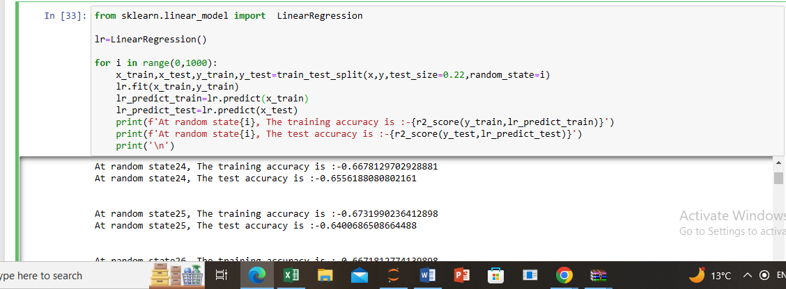
Testing of Identified Approaches (Algorithms)
Used train-test-split method to divide data for training model and testing it.

Slide 11
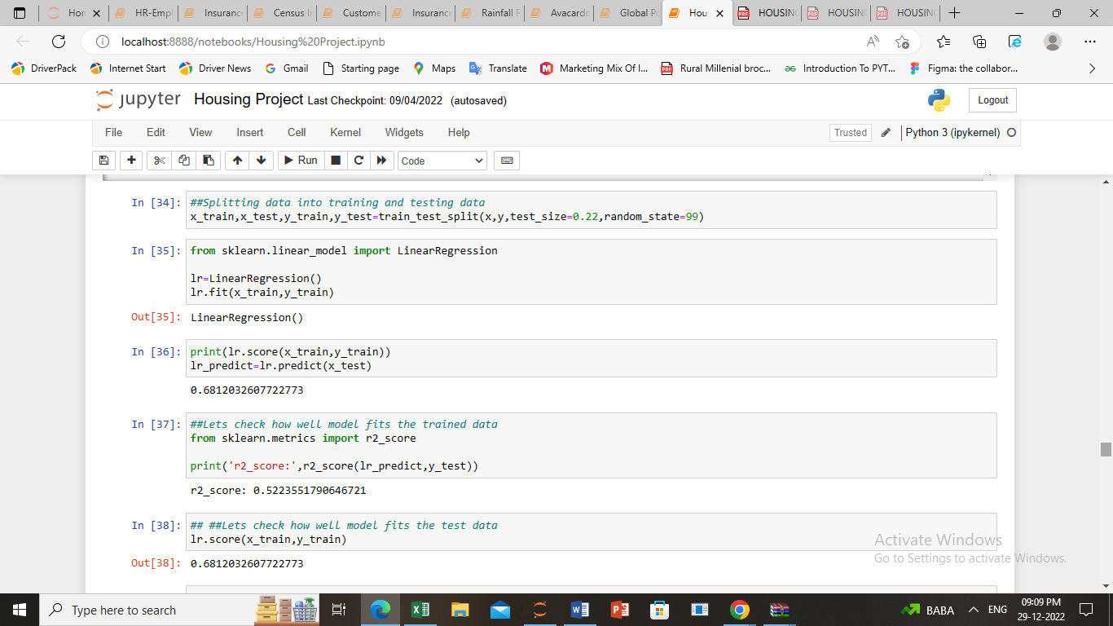
Run and Evaluate selected models

Slide 12
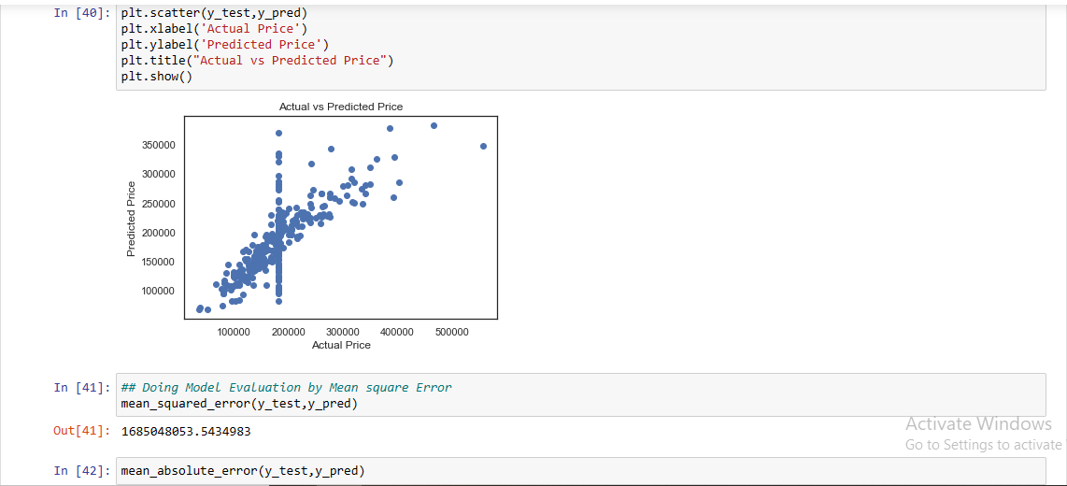
Linear Regression

Slide 13
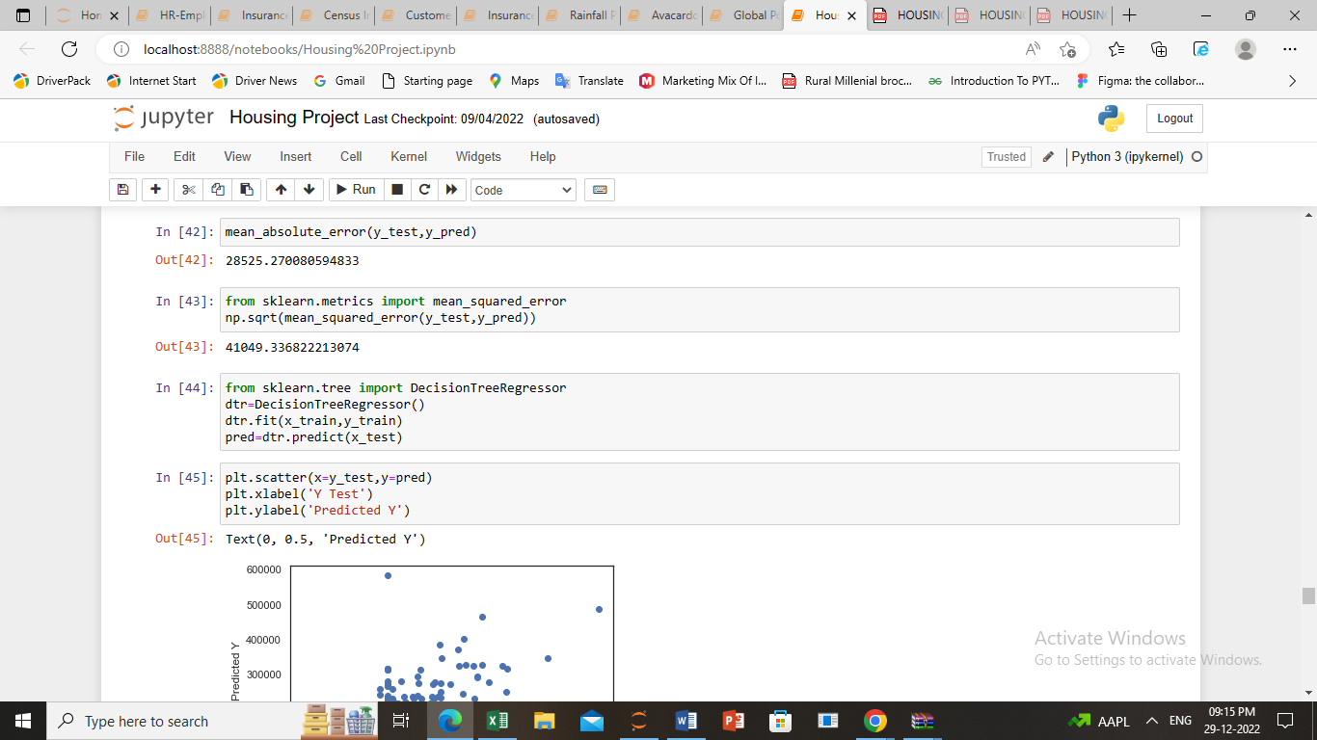
Cont…..

Slide 14
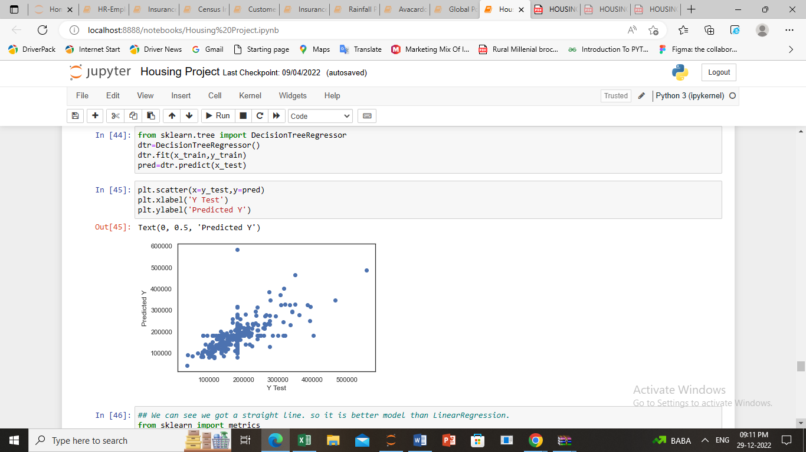
DecisionTreeRegressor

Slide 15
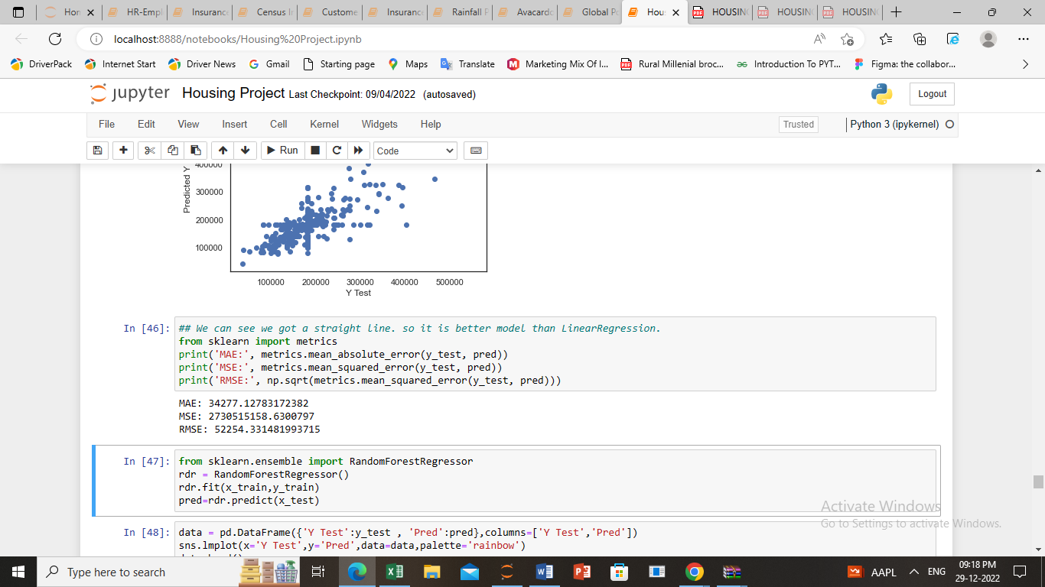
Cont…

Slide 16
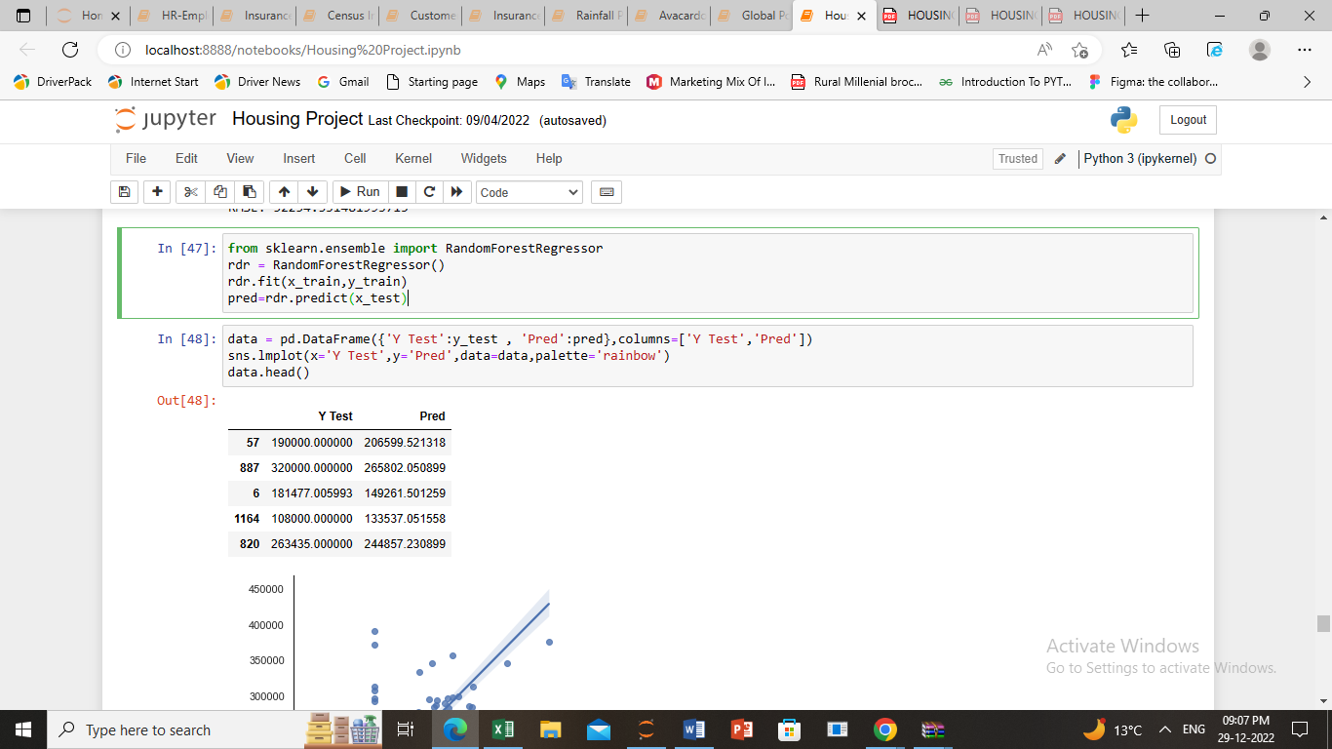
RandomForestRegressor

Slide 17
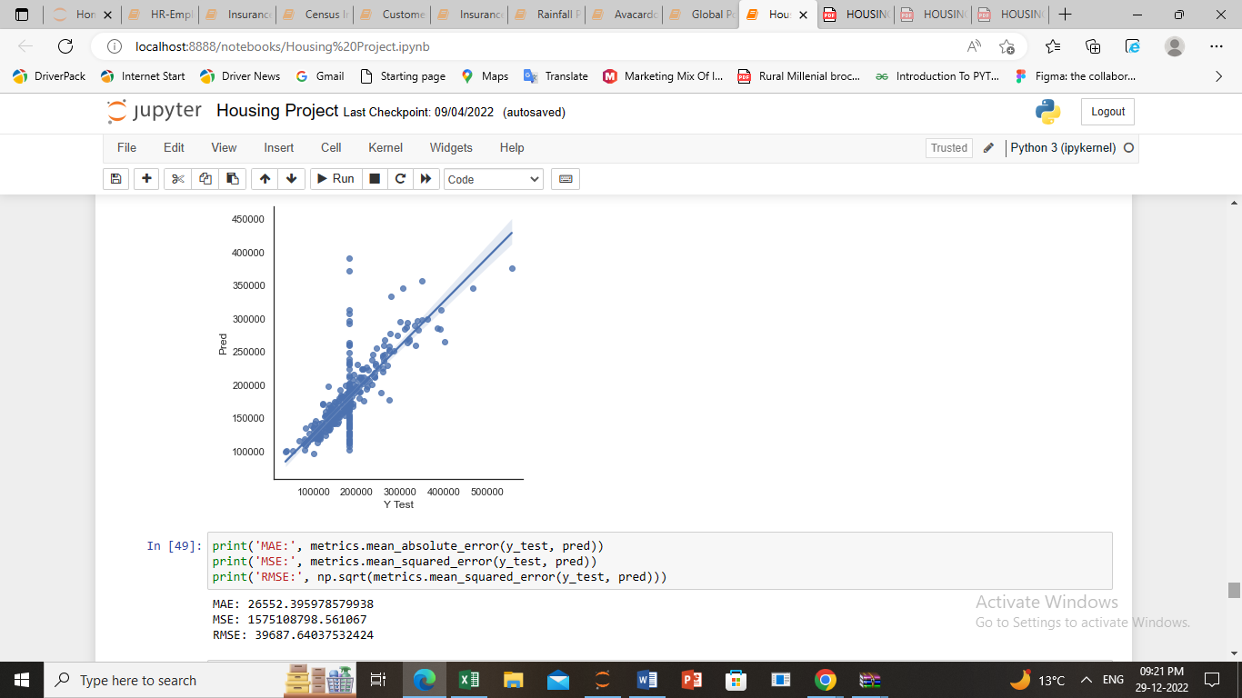
Cont…

Slide 18
Visualizations
I have done scatterplot visualization to see relation of different features with Target variable, to visualize skewness I have done sub-plotting and box-plotting to visualize outliers.
Interpretation of the Results
I came to know through analysis which model will be work with better accuracy with the help of low residual and RMSE scores.
In this project we can see that min RMSE is of Random Forest hence this can be a good model option

Slide 19
CONCLUSION
Key Findings and Conclusions of the Study
On the basis of above project we can see Random Forest has highest Accuracy value.
Also get to know where to use Linear, Decision Tree and other applicable and required models to fine tune the predictions.

Slide 20
Learning Outcomes of the Study in respect of Data Science
I have done EDA using Pandas and other plotting libraries.
Also made use of packages like matplotlib, plotly and seaborn to develop better insights about the data.
I also learnt how to create new features which will in turn help us to better predict the survival.
I get to know what are the features on which price is highly positively and negatively correlated with.
I came to know through analysis which model will be work with better accuracy with the help of low residual and RMSE scores.
In this project we can see that min RMSE is of Random Forest hence this can be a good model option
This project helped me to understand which model to choose first and go step by step to attain results with good accuracy.
In this project we have also seen importance of each features in ascending order.

